Slide 1
Collaborative Filtering Algorithms Evaluation
Gradient Descent with Probabilistic Assumptions VS Alternating Least Squares
Ting Cai, Qichao Chen, Lulu Dong, Kangkang Zhang

Slide 2


Slide 3
Objectives
Algorithms:
Gradient Descent with Probabilistic Assumptions
Alternating Least Squares
Compare Prediction Accuracy for those two algorithms before postprocessing
Postprocessing:
SVD with kernel ridge regression
Compare Prediction Accuracy for those two algorithms after postprocessing

Slide 4
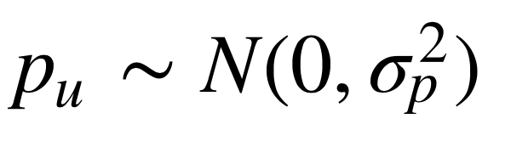
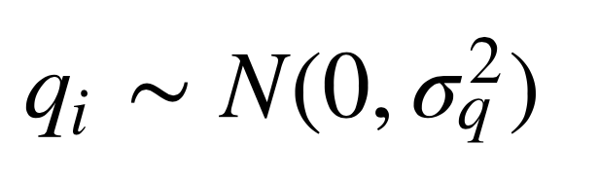
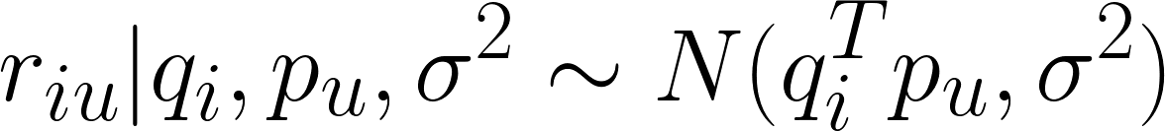
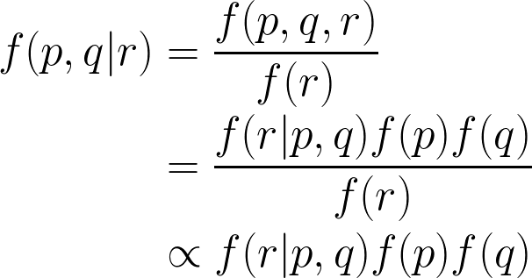
Methodology
Gradient Descent with Probabilistic Assumptions
user vector and movie vector follow gaussian distributions,
the conditional distribution over the observed ratings:
According to Bayes theroem,

Slide 5
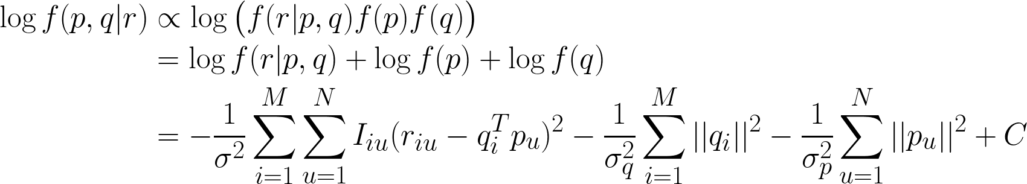

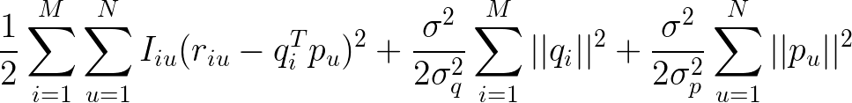
Methodology
Gradient Descent with Probabilistic Assumptions (PMF)
Log-likelihood function:
Can be converted to a minimum objective function by multiplying

Slide 6


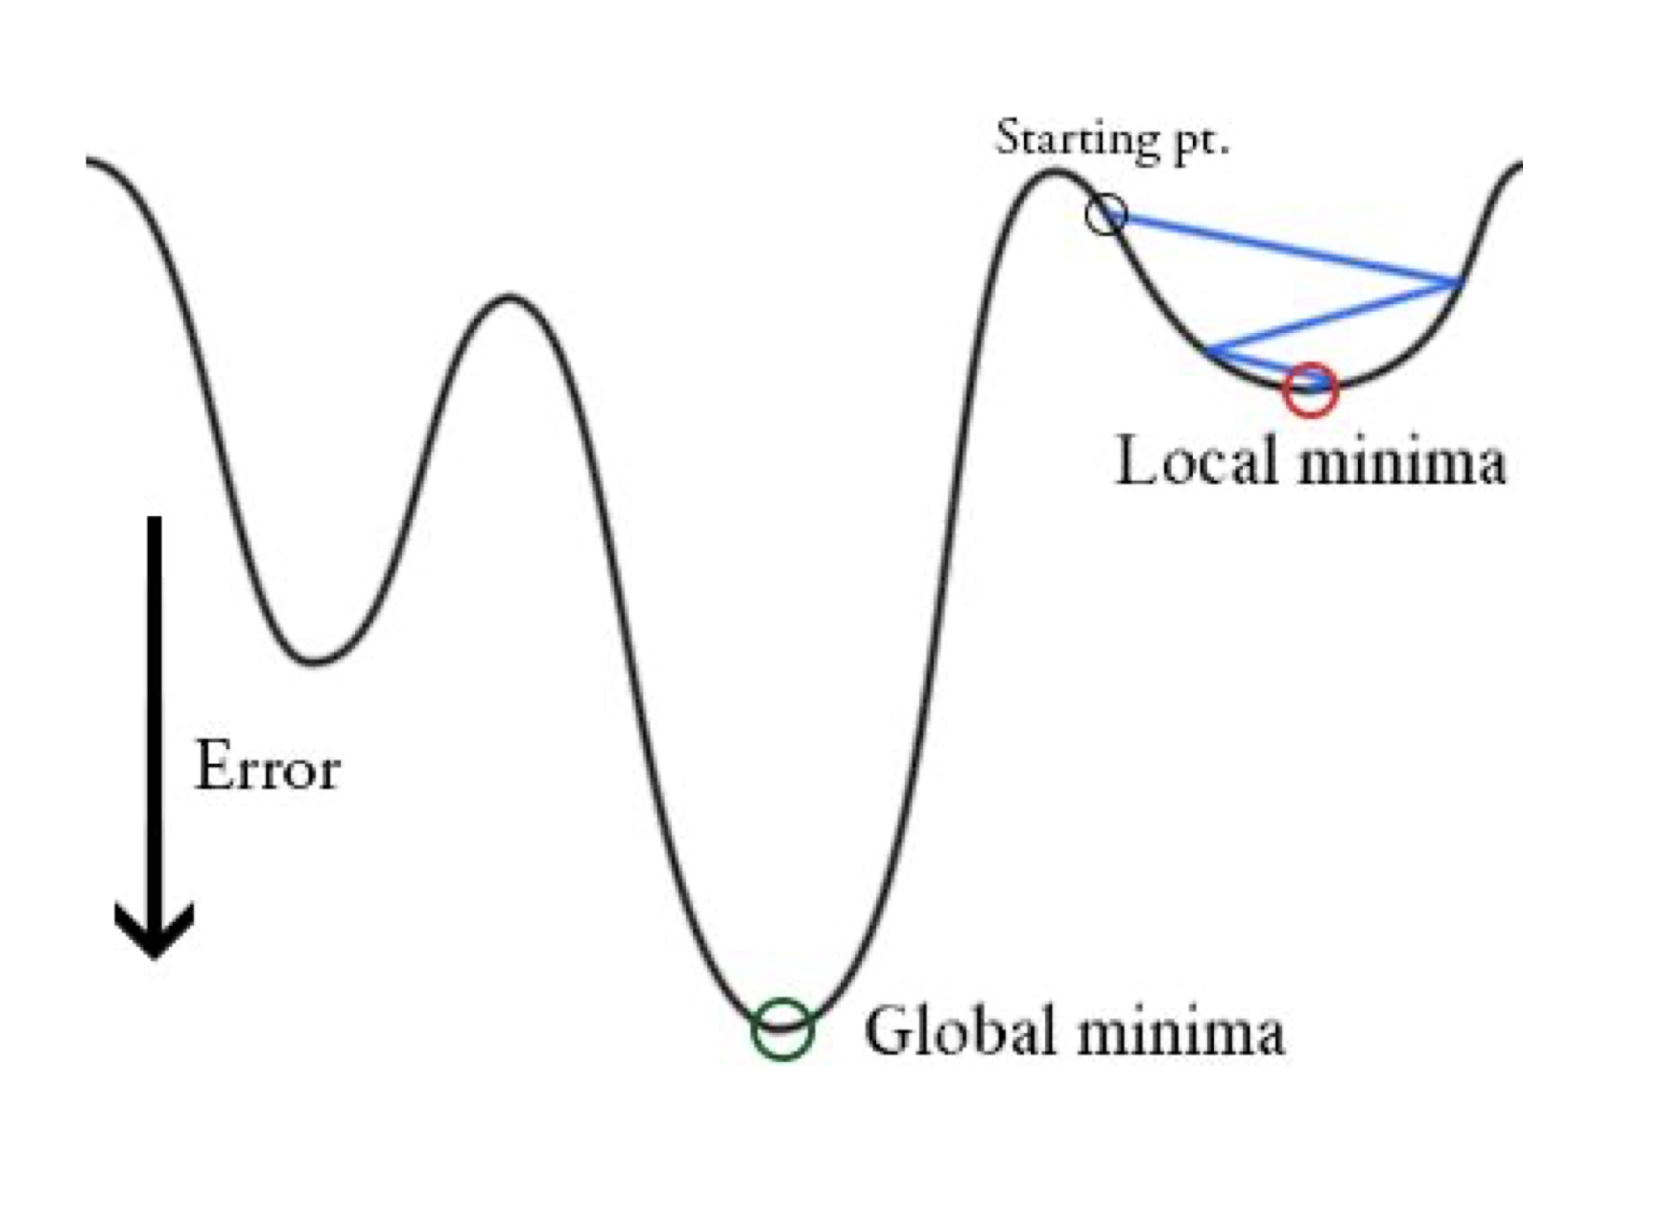
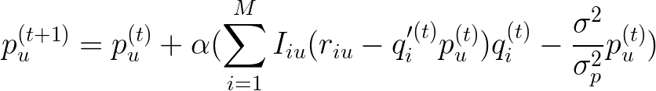
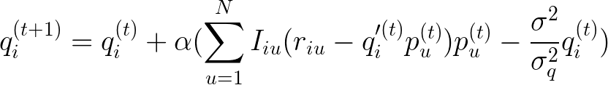

Methodology
Gradient Descent with Probabilistic Assumptions
Update with learning rate
However, for non-convex function, gradient descent might
only find local minimum and cost lots of iterations.

Slide 7
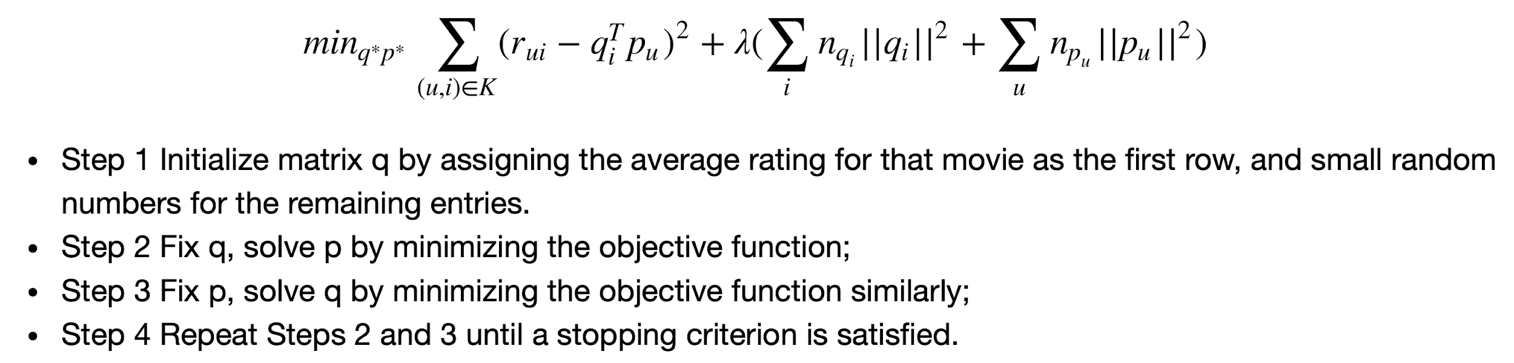

Methodology
Alternating Least Squares

Slide 8
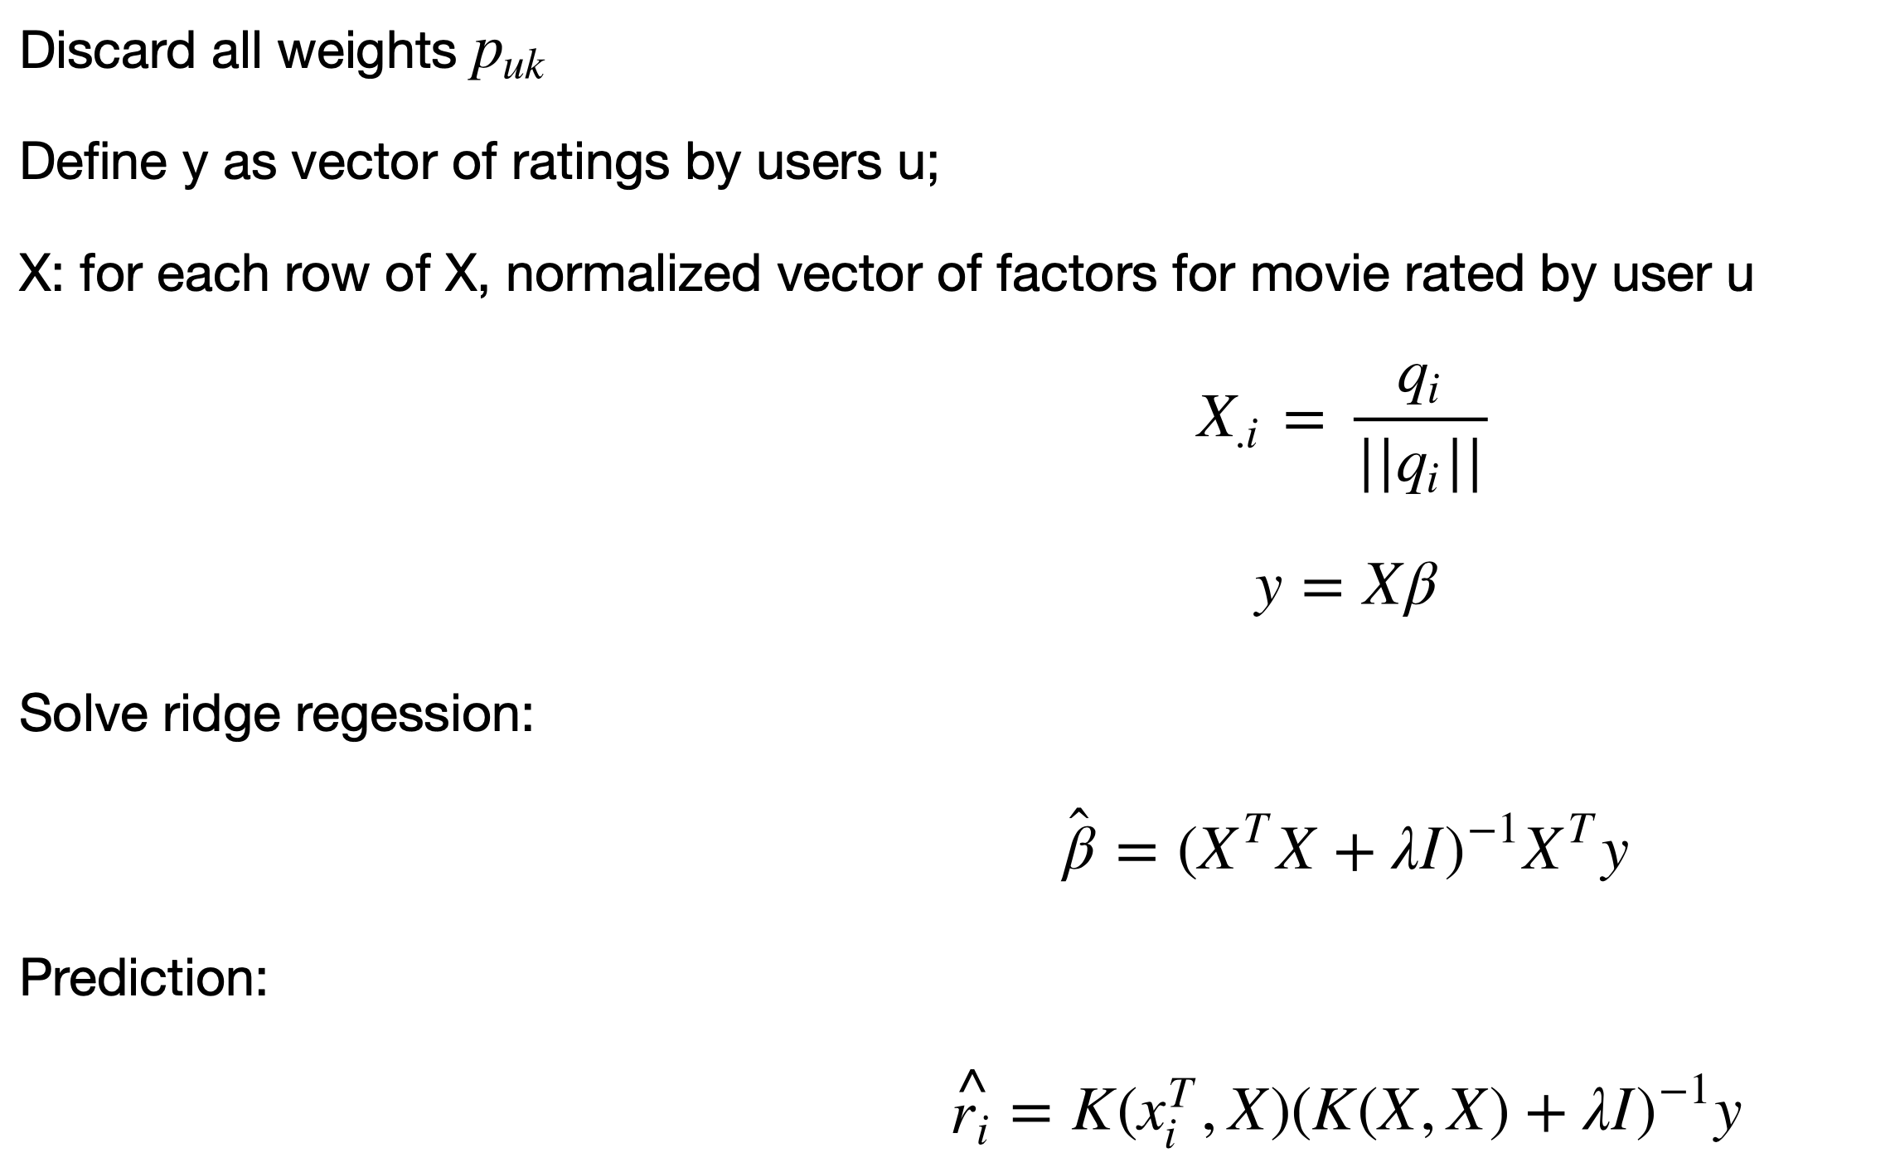

Methodology
Postprocessing SVD with kernel ridge regression

Slide 9
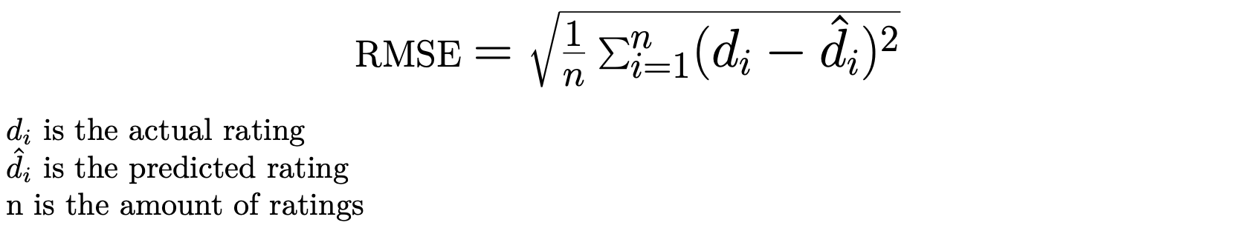
Evaluation Measurement
Root Mean Square Error (RMSE)

Slide 10
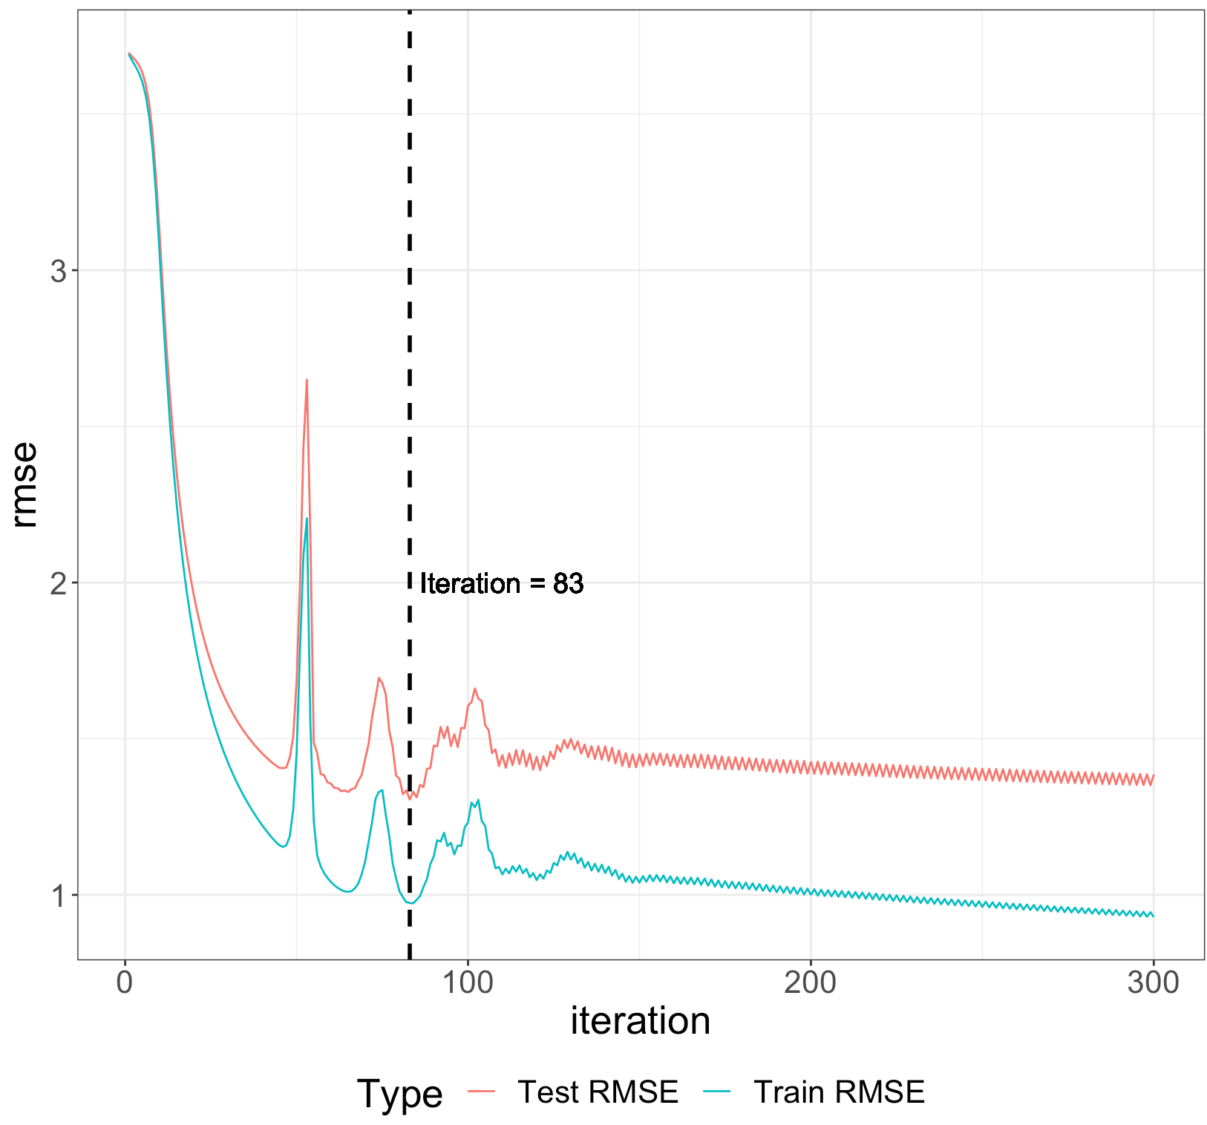
Experiment
Gradient Descent with Probabilistic Assumptions
18 different parameter sets for 5-Fold CV
Result:
= 0.001
= 0.1
# feature = 5

Slide 11
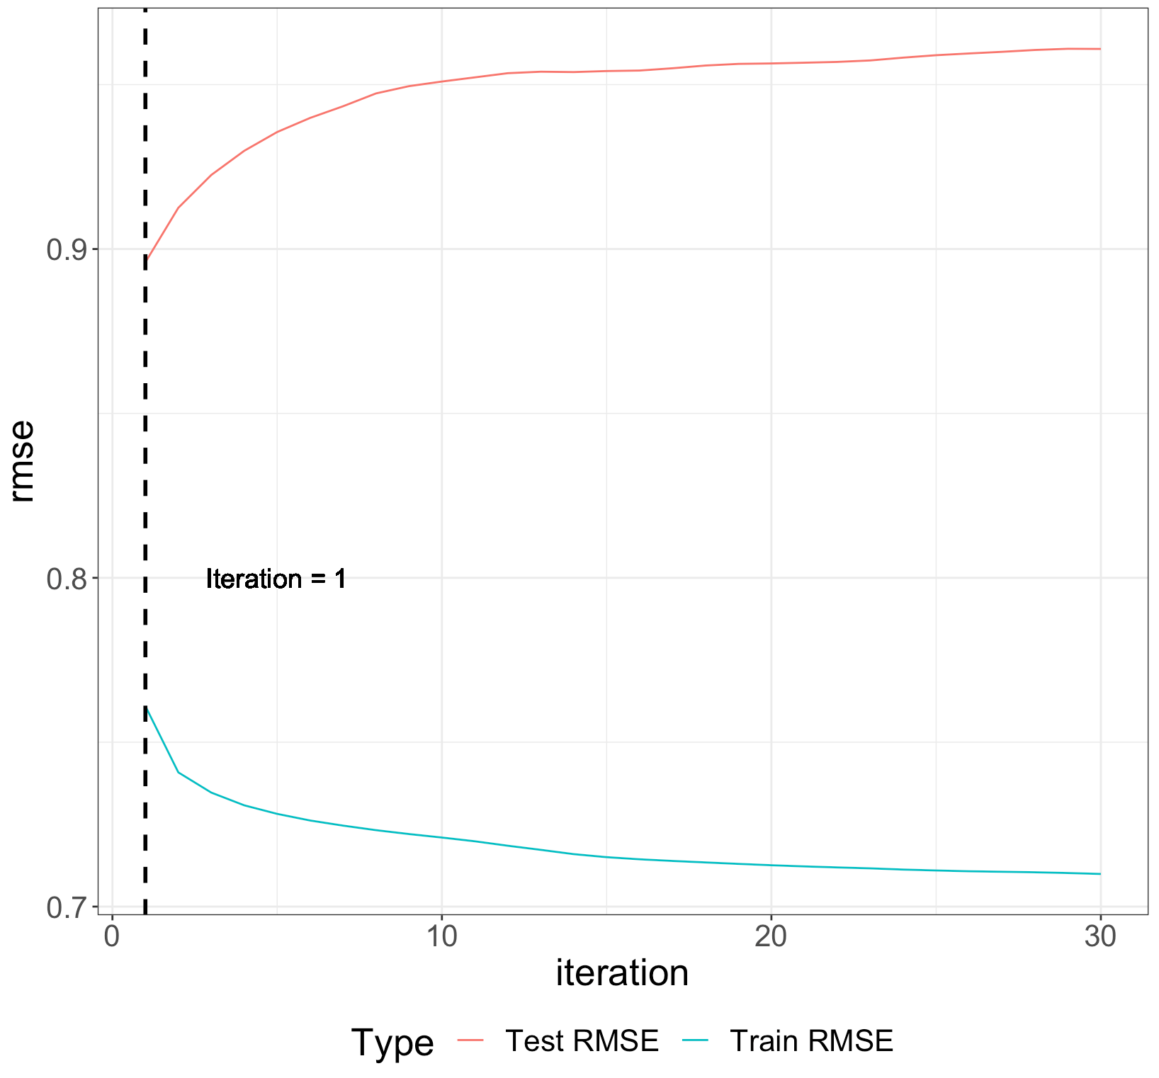
Experiment
Alternating Least Squares
4 different parameter sets for 5-Fold CV
Result:
= 0.01
# feature = 2

Slide 12
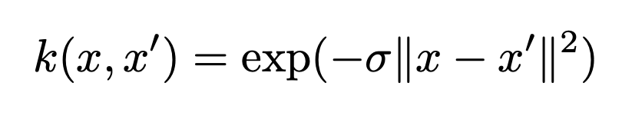
Experiment
Postprocessing SVD with kernel ridge regression
Gaussian radial basis function with sigma = 0.05
For each user, build a kernel ridge regression using normalized movie vectors in train set as predictors

Slide 13
Evaluation Result
 | Gradient Descent with Probabilistic Assumptions | Alternative Least Squares
RMSE before postprocessing | train: 0.974 test: 1.305 | train: 0.770 test: 0.896
RMSE after postprocessing | train: 0.847 test: 0.924 | train: 0.884 test : 0.956
Model training time | 38 min 51 sec | 9 min 15 sec

Slide 14
Conclusion
Gradient descent with Probabilistic Assumptions
much more time-consuming than ALS
hard to find the global minimum
RDF Kernel ridge regression
improves the accuracy of Gradient descent, while it decreases the accuracy of ALS
Given RDF Kernel ridge regression:
gradient descent has better accuracy performance on both train and test sets
Without RDF Kernel ridge regression
ALS has better accuracy performance on both train and test sets

Slide 15
Thanks for listening!

